Slide 1

TankMaster Introduction

Slide 2

Lesson Goals
Get basic knowledge about the TankMaster Software
What is TankMaster?
How does TankMaster work?
Which operations are available?
How to install TankMaster

Slide 3
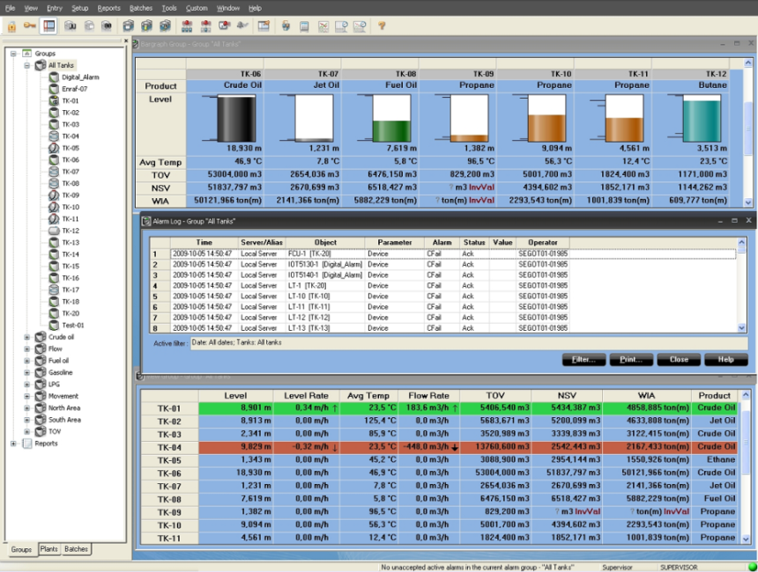
What is Tank Master?
TankMaster is
Developed by Rosemount Tank Radar
Specially developed to get the most out of an automatic tank gauging system
A configuration software
Installation/configuration of Rosemount field equipment
A tank inventory management software including
Inventory calculations
Batch handling
Report handling
Alarm handling
History sampling
Open communication interface
That easily connect to other HOSTS/DCS

Slide 4
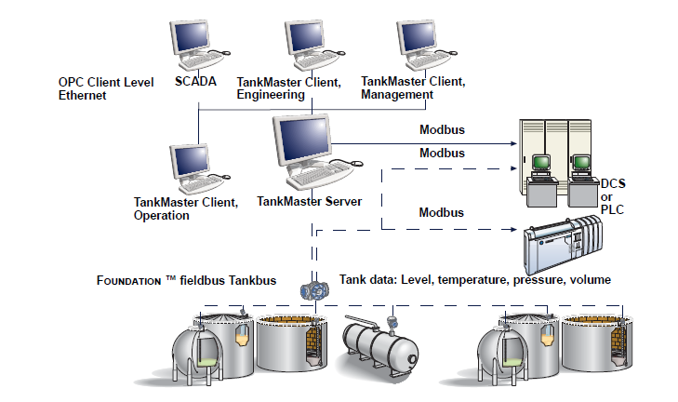

TankMaster® - A Unique Software
100% in-house developed
Windows platform
All languages...
Can easily be translated
OPC Server
Easy integration to other systems
Easy site customization
Visual Basic

Slide 5
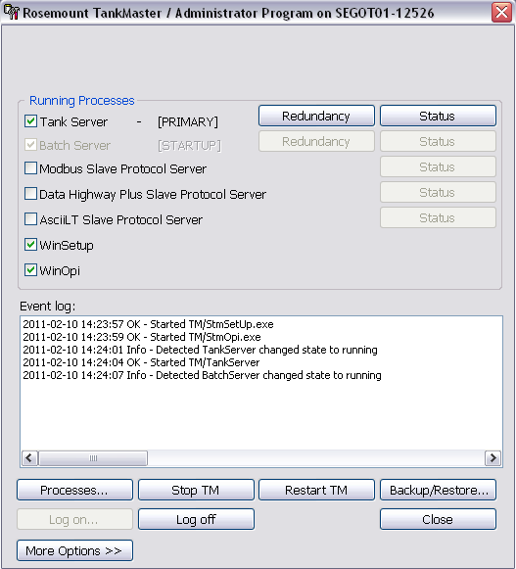
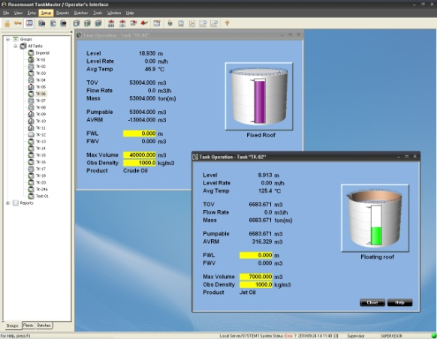
TankMaster - Programs
Administrator program
Administrator
User interface programs
WinOpi
WinSetup
WinView
TankMaster.net
System / Additional programs
Editor
TankServer
Master and Slave Servers

Slide 6
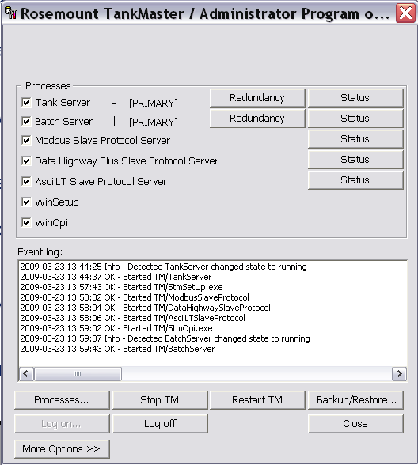
TankMaster - Administrator
Administrator program
”Task Manager” for TankMaster
Autostarts when PC is started (default setting)
Autostart of TankMaster programs at PC reboot
Status of TankMaster servers
View File info (e.g. version)
Backup function
Important to do when configuration is done
Restore function
Restor of backup

Slide 7
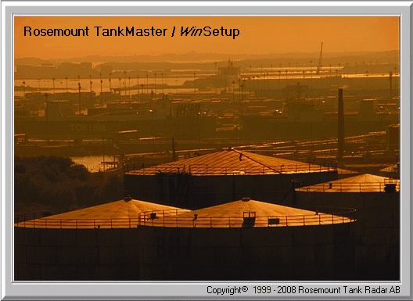
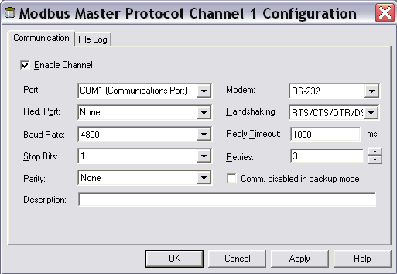
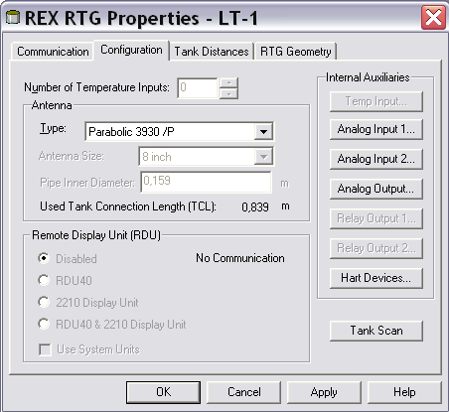
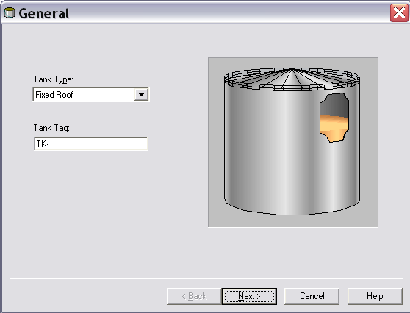
TankMaster - WinSetup
Graphical user interface for installation, configuration & service of Rosemount field equipment
Protocols
Enable protocols
Configure slave servers
COM port settings
Install/Configure field devices
FCU
Tank hub
5900, 5300, 5400
Rex, Pro, TRL2
DAUs
Install tanks
Connect field devices
Configure input parameters
Type of tank/strapping table
System unit
Notes:
WinSetup
Graphical user interface for installation, configuration and service of Saab field equipment
Protocols
Enable protocols
Configuring slave servers
COM Port settings
Install/Configure field devices
FCU
REX/ Pro/ TRL/2
DAUs
IO Terminals
Install tanks
Connect field devices
Configure input parameters
Type of tank/Strapping table
System unit

Slide 8

TankMaster WinOpi
Operator user interface
Tank inventory management
Realtime inventory calculations
According to API standard
Tank Groups
Product/Area
Product Table
Easy volume calculation setup/tank
Alarms
Management
Level/Volume/Flow/Leak alarms
Trends
Reports
Batch management

Slide 9

TankMaster WinView
WinView is a new cost effective version of WinOPI.
For smaller depots where full inventory calculation support is not needed
Excellent entry level to TM
Use the same WinSetup as WinOpi (no changes in WinSetup).
Is an option in the HW key.
Included functions:
Alarms
Host comunication (option in HW key)
Reports (log report) etc.
Excluded functions:
Batchfunction
Redundancy
Custody Transfer etc.
Notes:
TankMaster WinView is a software package with basic inventory capabilities. It is a cost efficient alternative for operational control at smaller tank terminals, marketing terminals, biofuels and chemical plants etc. Configuration is made with WinSetup, which is included in the delivery.

Slide 10
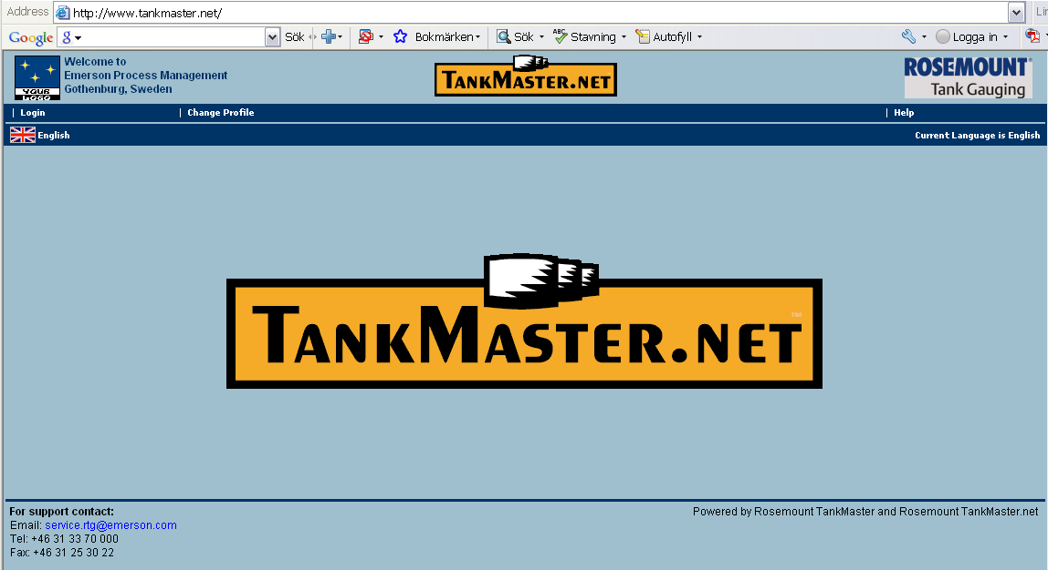
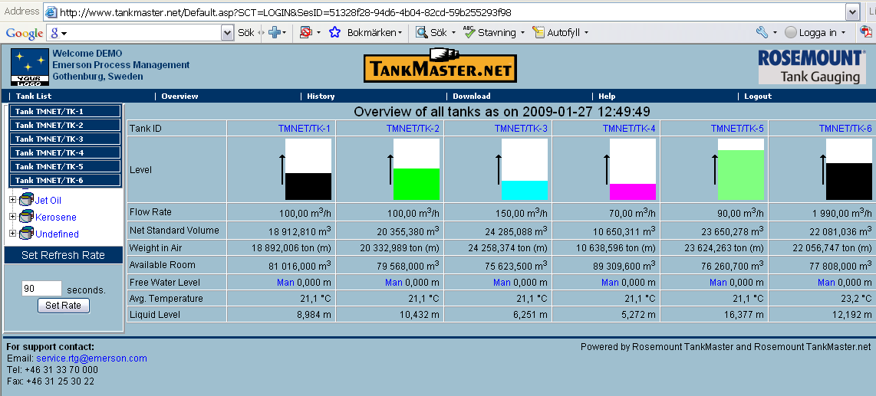
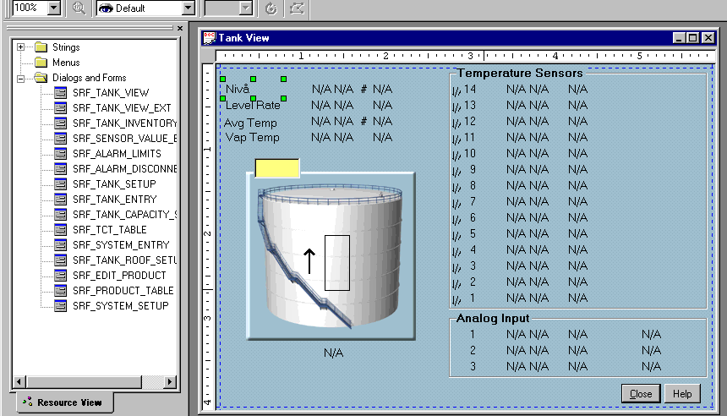
TankMaster.net & Editor
TankMaster.net
Note! Separate software
Creates a webpage presenting live data from connected Tank Master systems
Only internet explorer needed
View inventory data
View historical data
Make reports
Editor
Translate TankMaster
Special rebuild of windows and views

Slide 11
TankServer
TankServer
Core program in TankMaster
Collecting data from Master servers
Performs all inventory calculations
Handles all alarms
External hosts can connect to TankServer using OPC
Master Servers
Collecting data from field devices and provides data to tankserver
Modbus Master – rosemount Equipment
IOT Master – I/O Terminals
Enraf GPU Master – Enraf CIU / gauges
Slave Servers

Slide 12
Master Servers & Slave Servers
Master Servers
Collecting data from field devices and provides data to tankserver
Modbus Master – rosemount Equipment
IOT Master – I/O Terminals
Enraf GPU Master – Enraf CIU / gauges
Slave Servers
Provides data to DCS / HOST systems
Modbus Slave
ASCIILT Slave
Data Highway Plus Slave

Slide 13
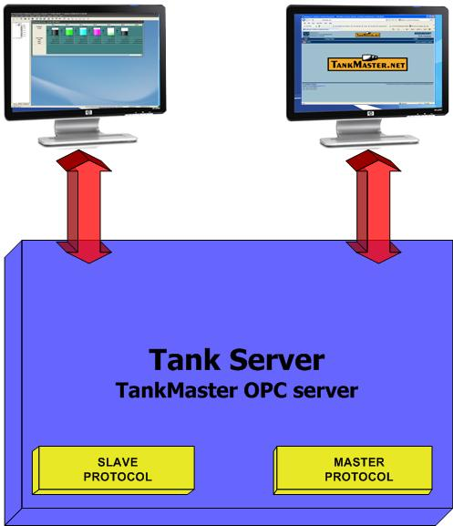
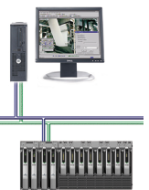

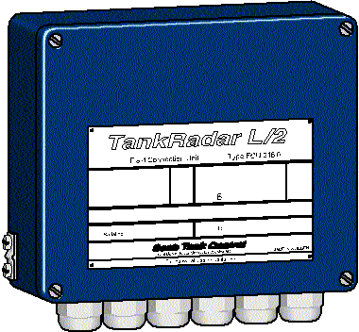

Program modules
PC Client Side
PC Server Side

Slide 14
Network Connection
TankMaster runs on Standard Windows network in Local Area Network (LAN) and Wide Area Network (WAN)
Connection to HOST/DCS system
Inventory Data public via TankMaster.net
Several WinOpi clients to same tankserver
www.tankmaster.net
W W W
TANK SERVER
TANK SERVER
TM.Net
TANK SERVER
Ethernet
LAN
WAN
DCS
CLIENT
CLIENT
CLIENT
CLIENT
Notes:
TankMaster runs on Standard Windows network in Local Area Network (LAN) and Wide Area Network (WAN)
Connection to HOST/DCS system
Inventory Data public via TankMaster.Net
Several WinOpi clients to same tankserver

Slide 15
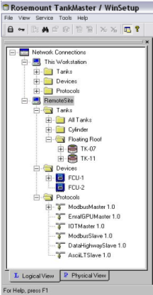
Network handling
All functions that can be performed locally can also be done to remote sites
WinSetup
Installation of tanks
Installation and configuration of devices
Setup protocols
View real-time communication log
WinOpi
Display Tank Inventory information
Alarm handling
Connection of several servers at the same time

Slide 16
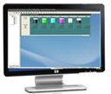
TankMaster - In a Network
LAN - Ethernet
Server PC
Client PC
WinSetup
WinOPI
WinSetup
WinOPI
Client Side
Client Side
Server Side
Server Side
Tank Server
Slave
Servers
Modbus Master
Master Servers
DCS, HOST
Slave Device
External Device

Slide 17
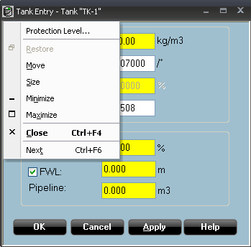
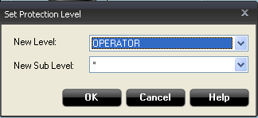
TM - Protection Levels
Administrator
Default password: admin
Network configuration
User accounts
Supervisor
Default password: super
Configuration of system, protocols, devices and tanks
Tools, Closing WinOpi, Creating Alarm Groups
Operator
Default password: oper
Entry functions, creating groups, accepting alarms
Wiew Only
Default password: view

Slide 18
TM - Protection Levels
User Manager
Manage user account
Add/remove user accounts
Change user level
Protection Level
Possible to set access level
Accepting alarms
Report handling
All windows in TankMaster
Possible to lock PC to only run WinOpi
WinOpi always run maximized
Not possible to change ot any other program
Audit Log
Log all actions done by operator logged in
Notes:
TA BORT!?!?!?

Slide 19
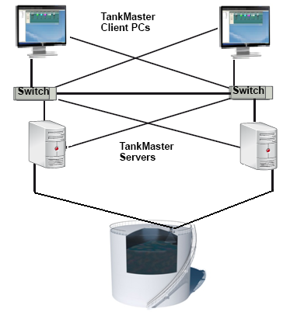
TM Redundant System
A redundant system gives
High availability
No work stop
No data loss
Redundancy for:
Inventory calculations
Alarm handling
Batch handling

Slide 20
TM Redundancy Normal operation
WinOpi clients are always connected to primary server
Auto detect Primary/Backup
Tankserver and Batchserver
Data is replicated from primary to backup
Only configure devices on one PC
Installation of new devices and tanks is possible
Tankservers work in ”Hot Redundancy”
Both servers are polling data from FCU
Online data from field is polled from both servers

Slide 21
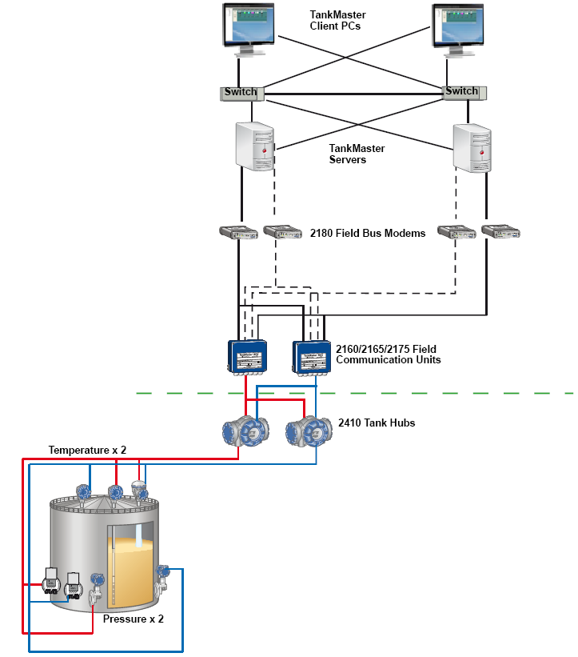
Complete Redundant System
Vital parts exist in pair
If one part fails the other takes over automatically
”hot redundancy”
Switch Redundancy
TankMaster redundancy
Inventory calculations
Alarms
ModbusMaster redundancy
Comports/FBM
2140/FCU communication
FCU 2160/2165/2175 redundancy (optional)
2410 redundancy
Field communication
Fieldbus redundancy
5900 redundancy

Slide 22
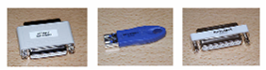
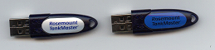


TankMaster Hardware Key
Key only required in TM Server
No driver needed
Different types of keys
WinOpi: Silver with black text
WinView: Silver with blue text
WinSetup: Silver with green text
Service (48h): Red with black text
Service (unlimited time): Silver with red text
TM.Net: Yellow with black text
Old TankMaster keys. Works on version 6.A1 build 14 and older
New TankMaster keys. Works on version 6.A1 build 15 and later

Slide 23
Tank Master Requirements
TM-04-0060 ”TankMaster minimum Requirements
PC requirements for TankMaster 4.G0 or higher
Hard drive: 40 GB (TM needs approx. 500 MB)
Two RS-232 ports (USB can be used instead)
One parallell port or USB for TM hardware key
Graphical card: 1152*864, 65536 colors
Hardware key: One key for each PC with a TM server or client
Hardware TankMaster Network PC
Known brand PC – 2 GHz, 2048 MB RAM (up to 20 tanks: 1024 MB)
Hardware TankMaster Standalone or Client PC
Known brand PC – 1 GHz, 1024 MB RAM (up to 20 tanks: 512 MB)
Operatin system, 4.H1 and earlier
Windows XP SP2
Windows 2003 Server
Operating systems, 5.B0 and higher
Windows Vista, SP1
Windows XP, SP2 & SP3

Slide 24
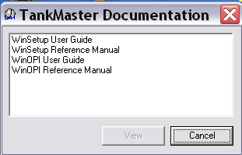
TankMaster Installation
Starts installation of TankMaster
Installs field device ini file package
Installs acrobat reader, needed for reading user’s guide

Slide 25
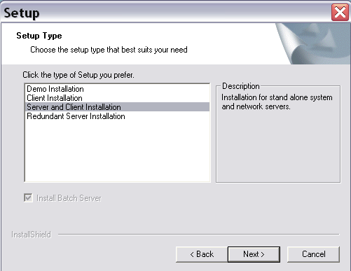
TankMaster Installation
Install Demo
Possible to run WinOpi without hardware dongle
Good to use for practice of all functions in WinOpi
Demo for customer
Program Files and User Gui
Install ’sharp’ version of TM
Software modules being installed
WinOpi
WinSetup
TankServer
Master/Slave Protocol Servers
Installation requires reboot of PC

Slide 26
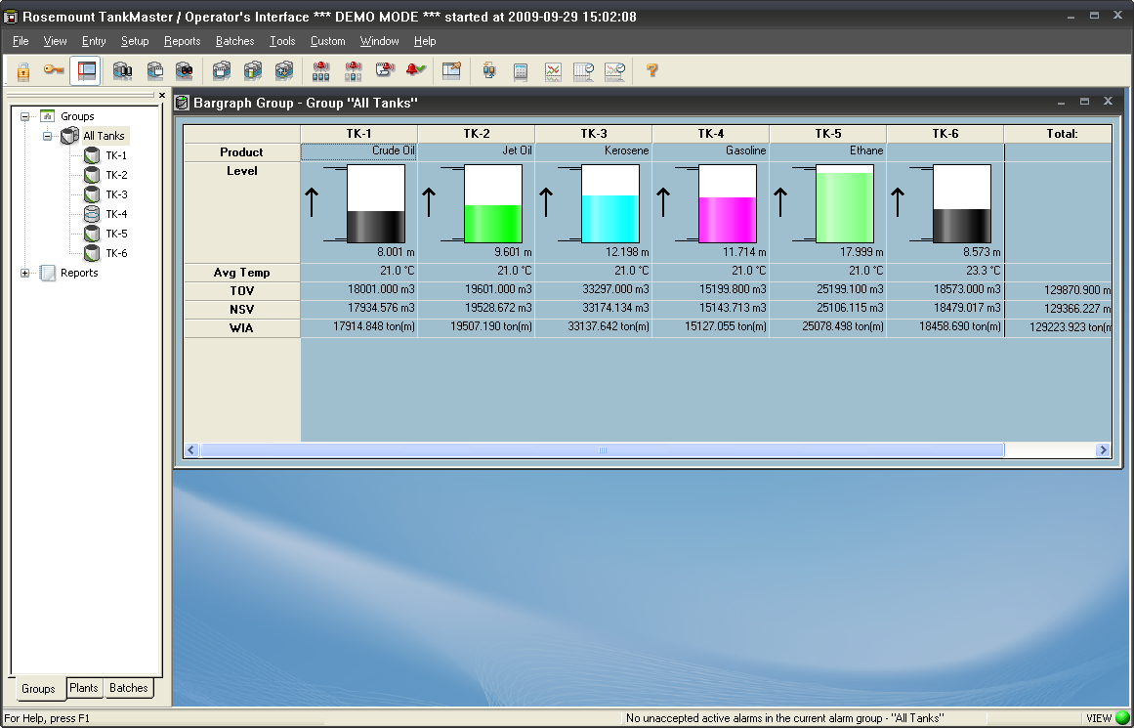
TankMaster Demo
If Demo installed
TM Demo database needed to be installed afterwards
Will install 6 tanks which is preconfigured with volume/density calculations
Level will automatically go up and down
Test
Alarm handling
Batch handling
Reports
Historical data
More...

Slide 27
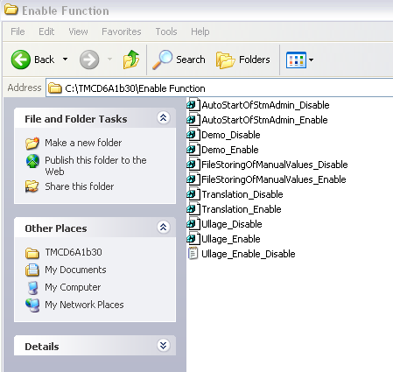
TankMaster Demo
Switching betweed demo and real mode
Done by using two reg files
Found on TM installation CD under \Enable Function
To enable DEMO click Demo_Enable
To disable DEMO click unreg Demo_Disable

